Slide 1

Group 30 model documentation

Slide 2
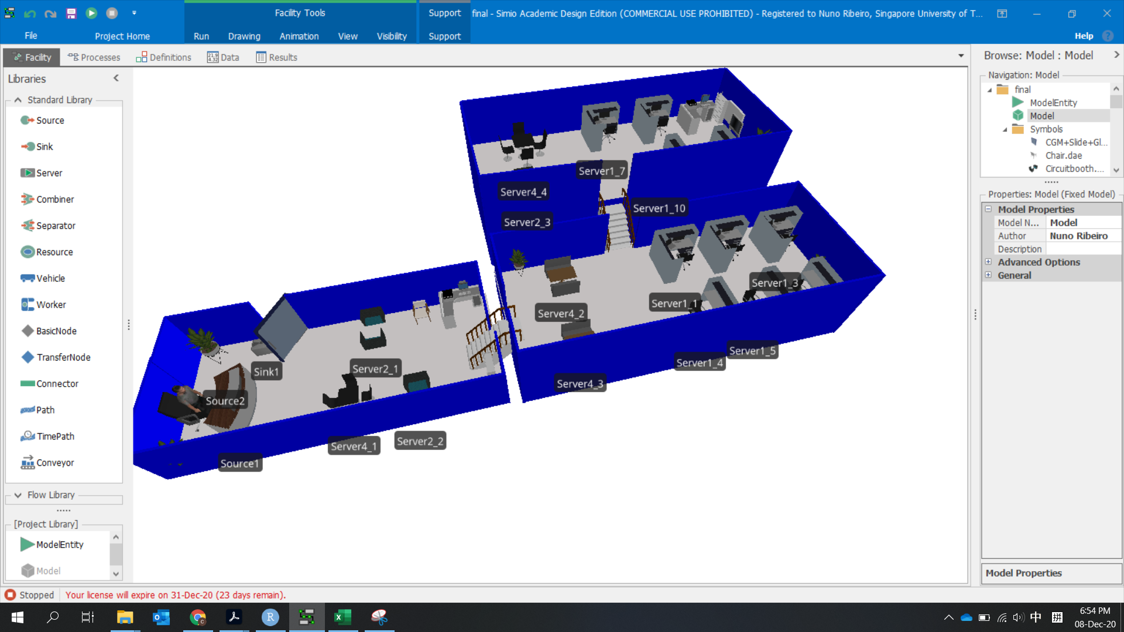
Using Simio, we create a model of study rooms and how students' groups of different sizes could utilize spaces available. *The model’s logic can be easily scaled to match any real place and accurately model them

Slide 3
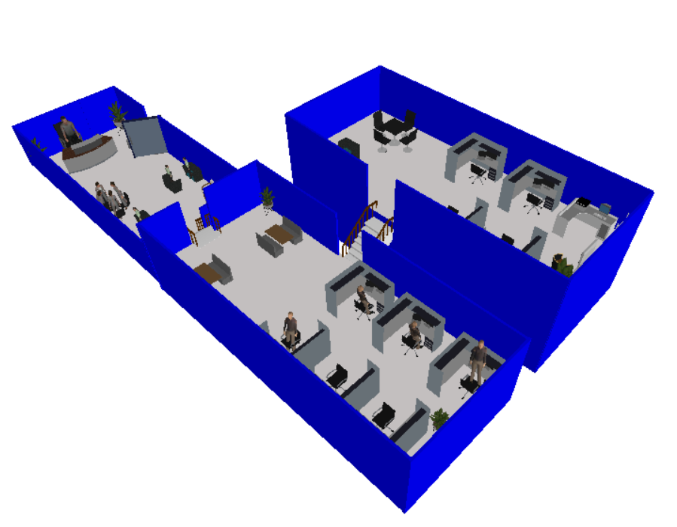
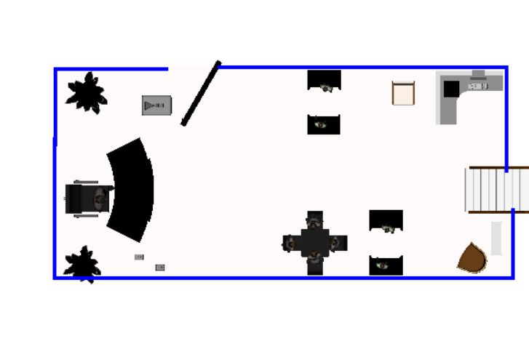
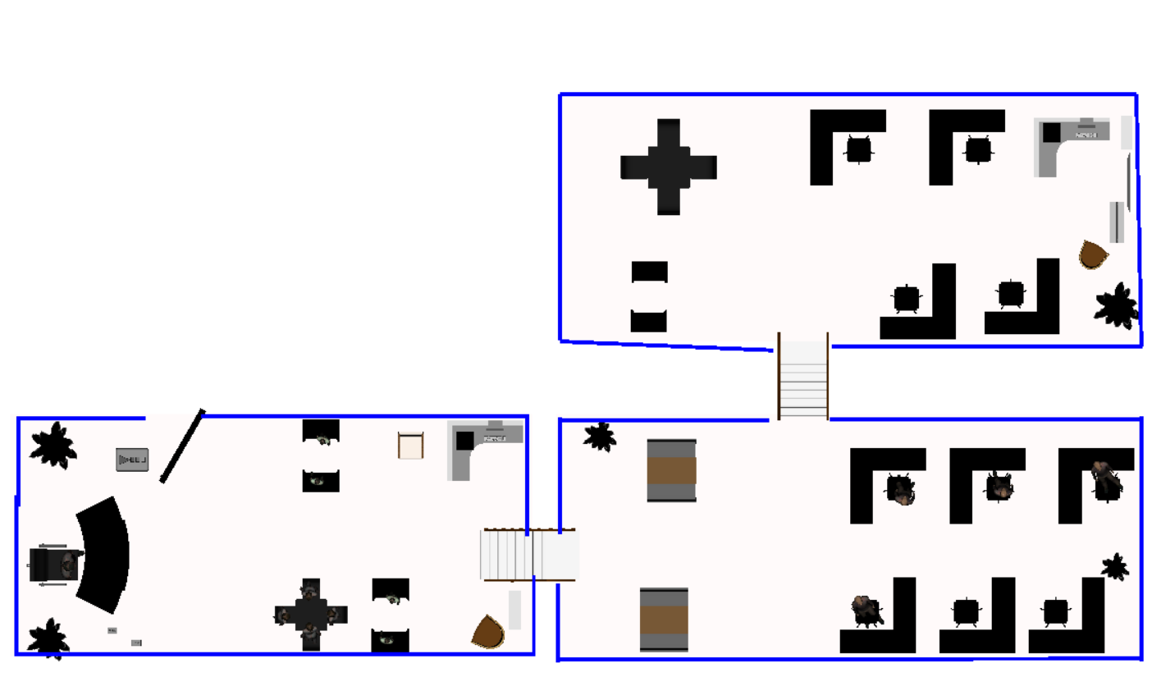
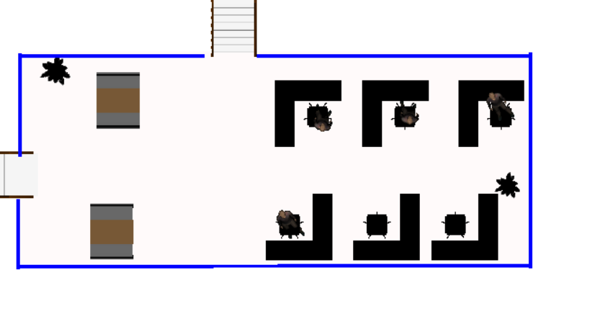
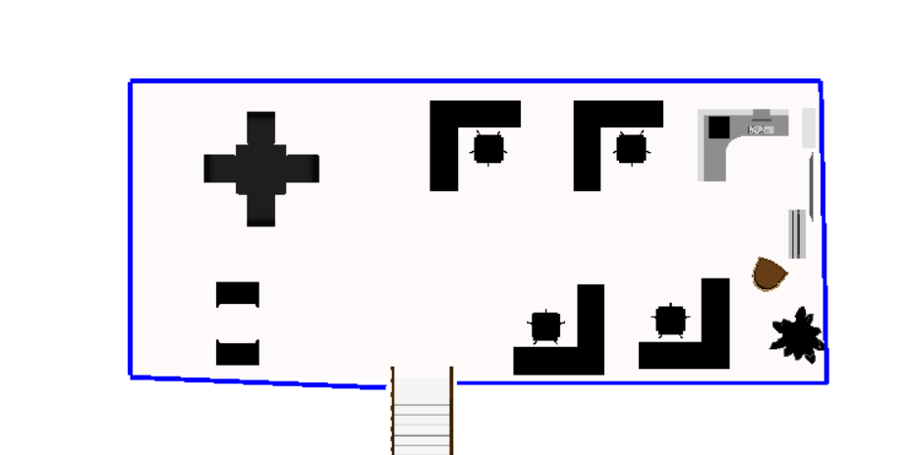
Like SUTD’s Library, our model has 3 levels. Each with a varying number of seats available.
Level 1
Entrance and Exit
2 pair seating
1 4-chair table
Level 3
Level 2
6 self-study
2 4-chair table
Level 3
4 self-study
1 pair seating
1 4-chair table
Level 1
Level 2

Slide 4
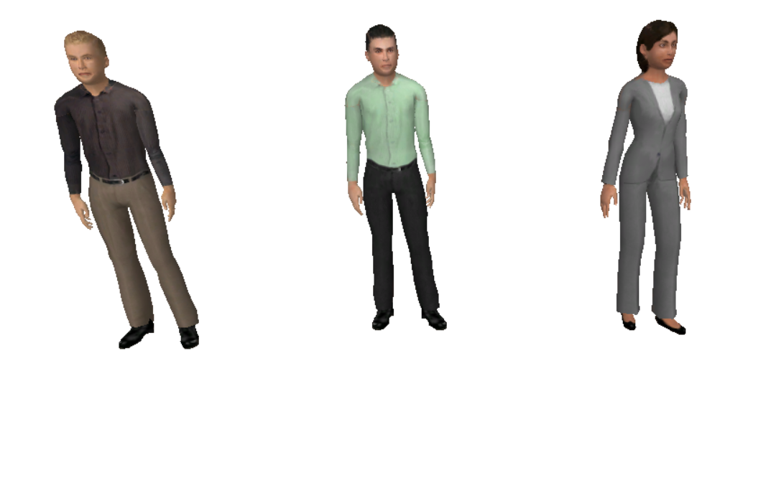
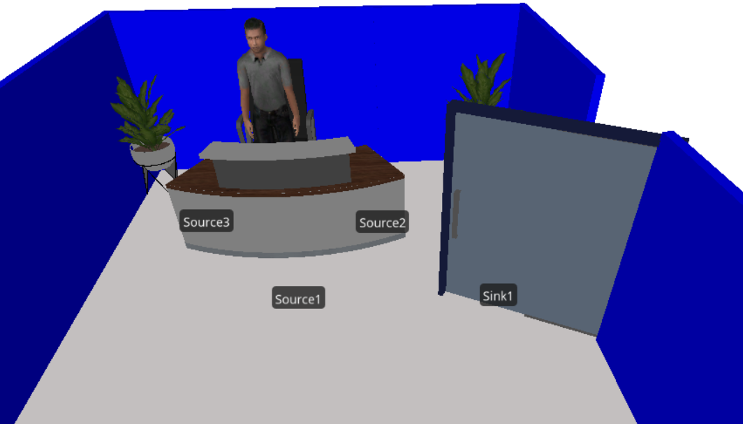
Starting at the front desk entrance, the model generates entities representing our different study groups. They then look for seats
Model Representations
Librarian
Individual
(Self-study)
Pairs
Groups of 4
If they cannot find a seat, they then leave through the exit.

Slide 5
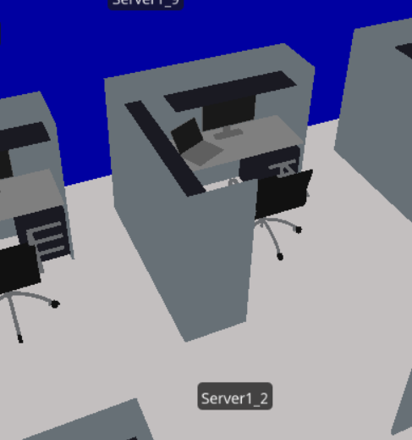
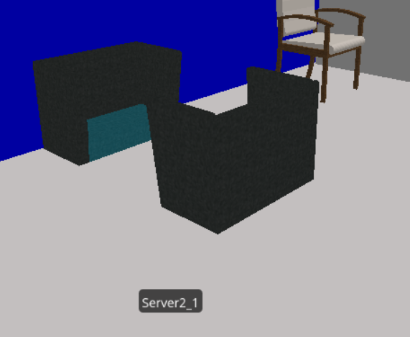
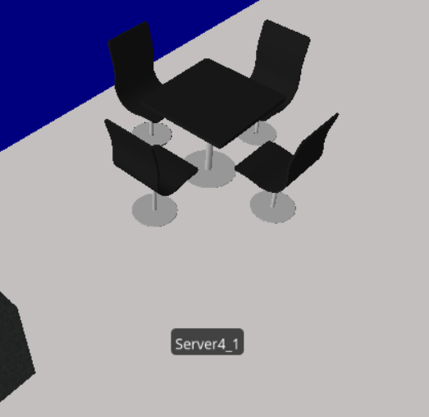
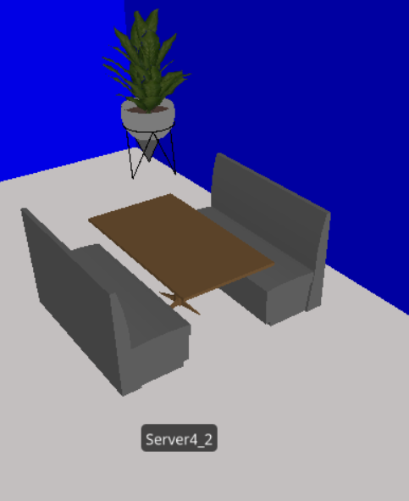
The Students, starting at Level 1, look for the closest available seat suitable for their use case. (individuals look for single seats, pairs look for pair seating, groups of 4 take tables) Once they are done studying, they leave, and the seat becomes available for the next student(s) to come along.
Individual
(Self-study)
Pairs
Groups of 4

Slide 6

Model Details

Slide 7
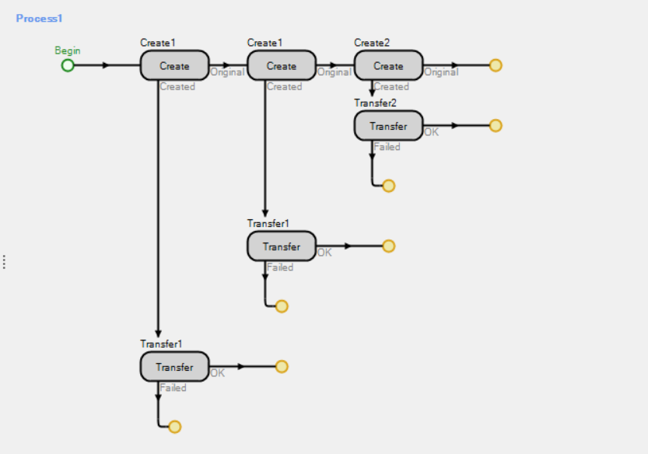
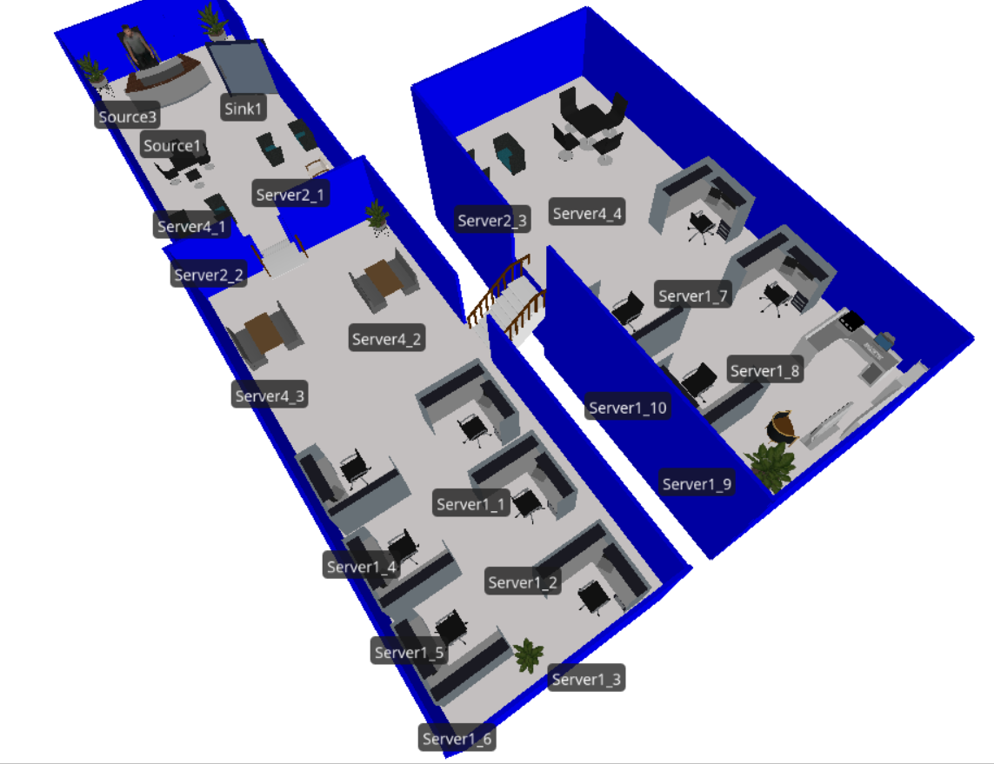
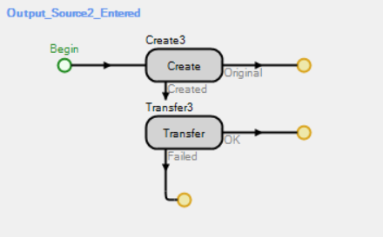
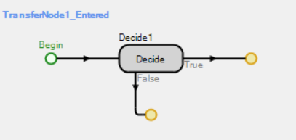
Internal Simio Logic
By building an internal logic within Simio, we modelled the behavior of students and how they move within the space to find their seats.

Slide 8
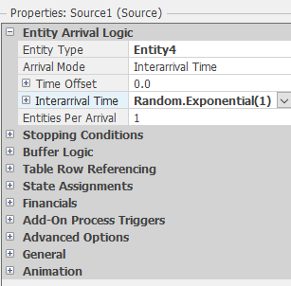
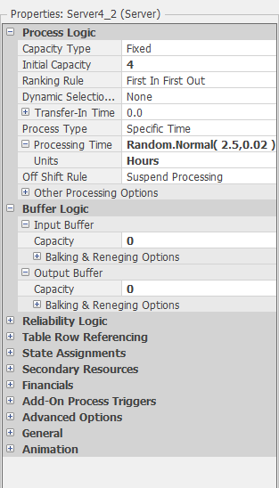
Students interarrival time follows exponential distribution
Students study time follows normal distribution (2.5,0.02)

Slide 9
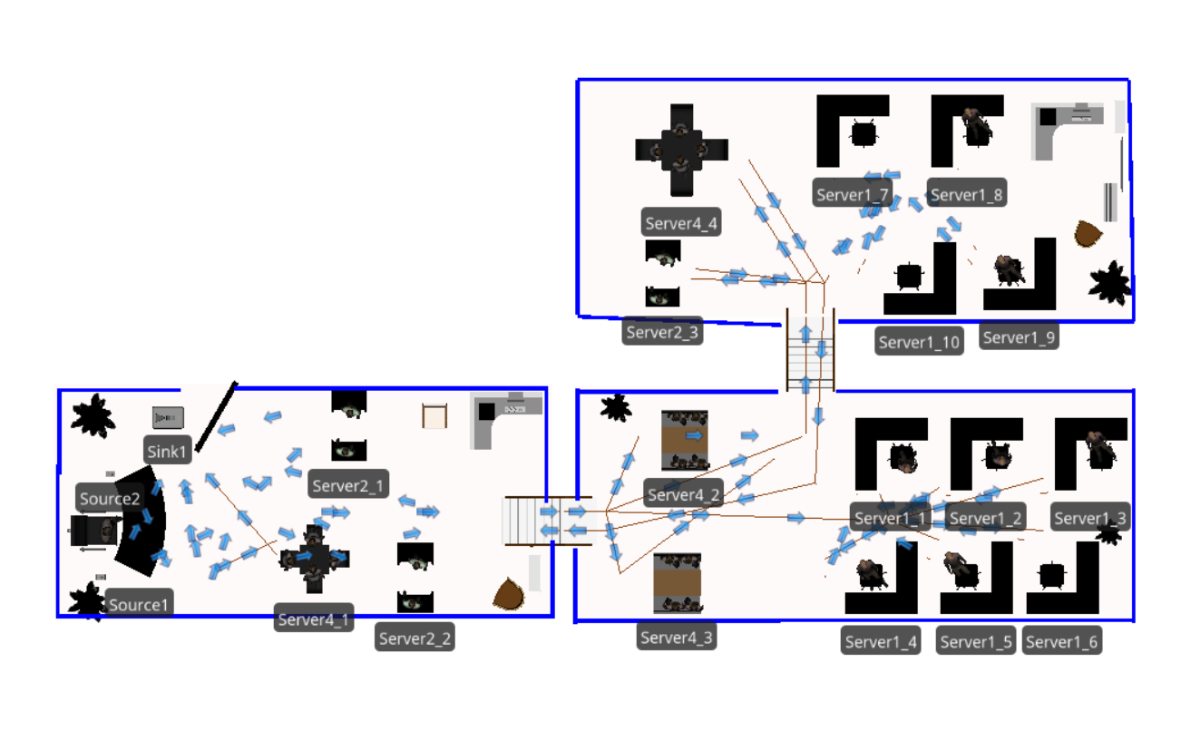
As the model is run, the system routes each student entity to seat server, from which we can generate useable data of the students’ utilization of the space.

Slide 10
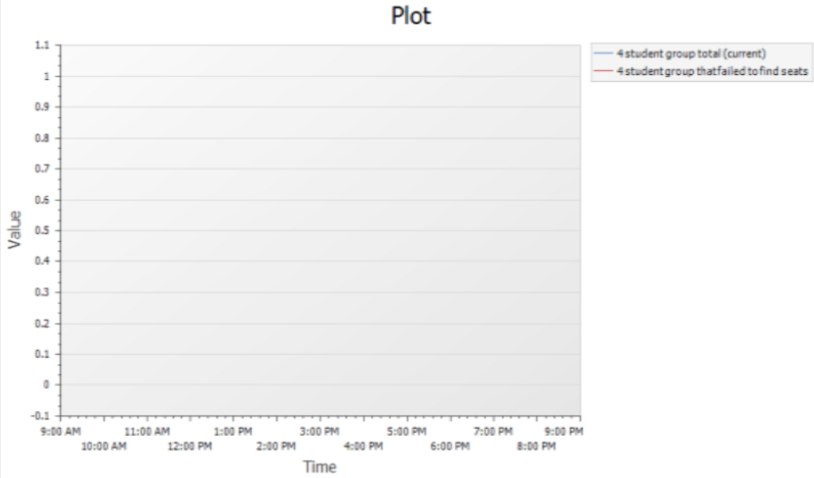
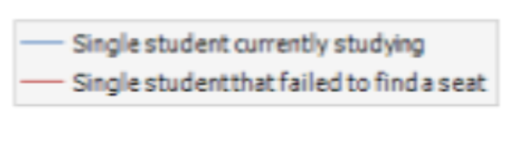
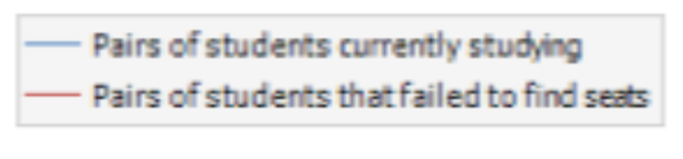
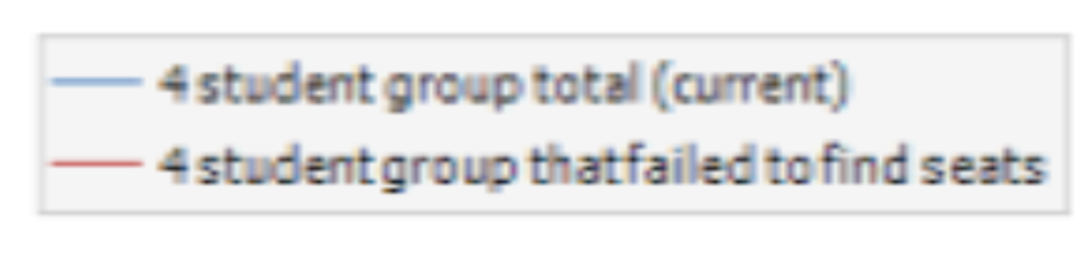
Simio’s inbuilt widgets allow accurate and visual-friendly data presentation
We built on it to provide model users with clear representation of each stat.

Slide 11
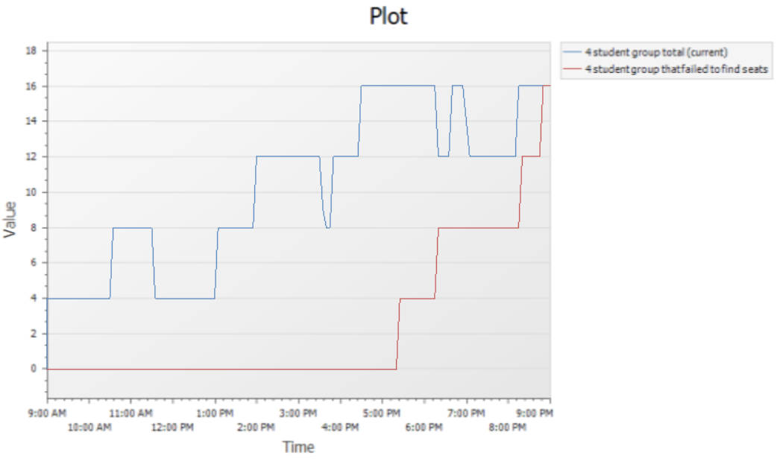
Y-axis: Number of students
Blue: In groups of 4 currently using the study rooms
Red: total number of students that failed to find a seat
X-axis: Relative time scale from 9am to 9pm.
Once run, the model self-generates all the data we need to evaluate the situation and make decisions.

Slide 12
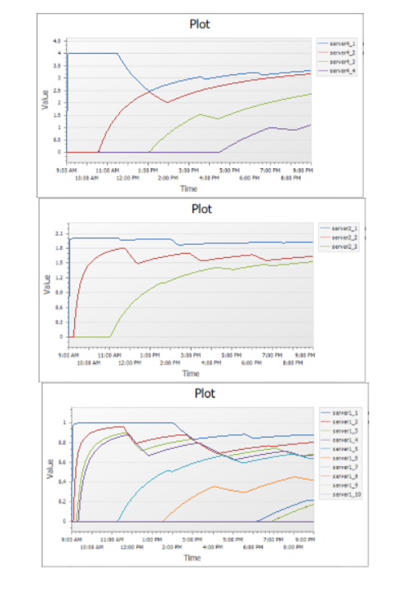
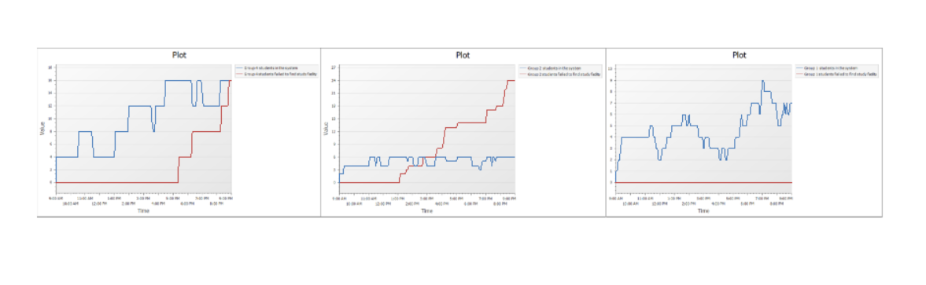
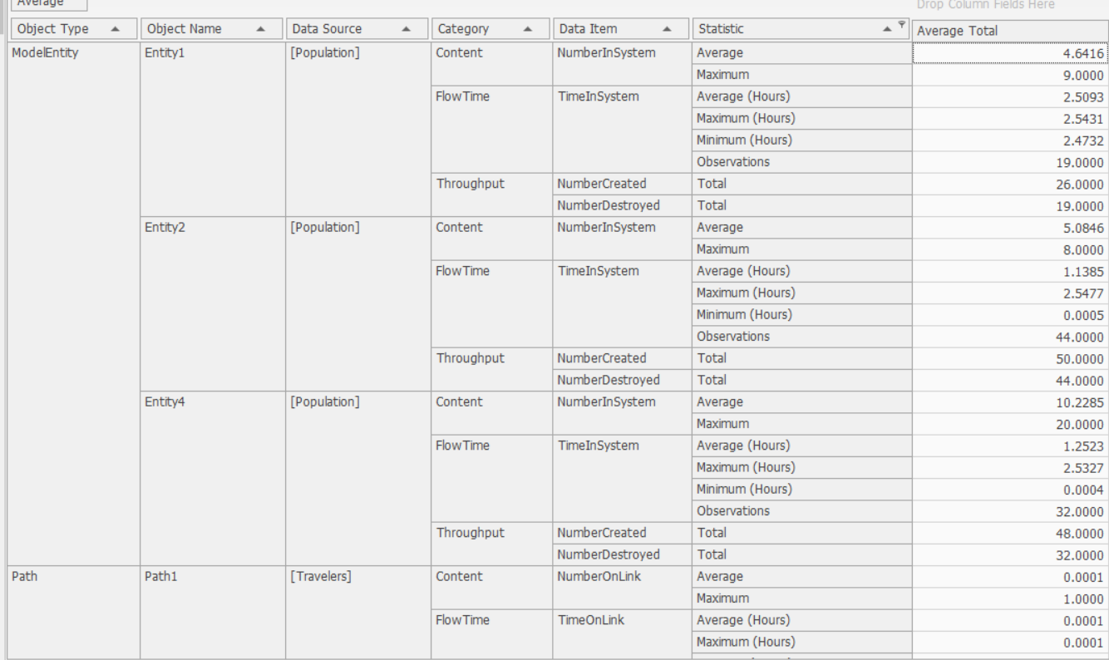
Examples of Data collectable
Current students and students that failed to find seats
Extractable data
Seat Utilization

Slide 13
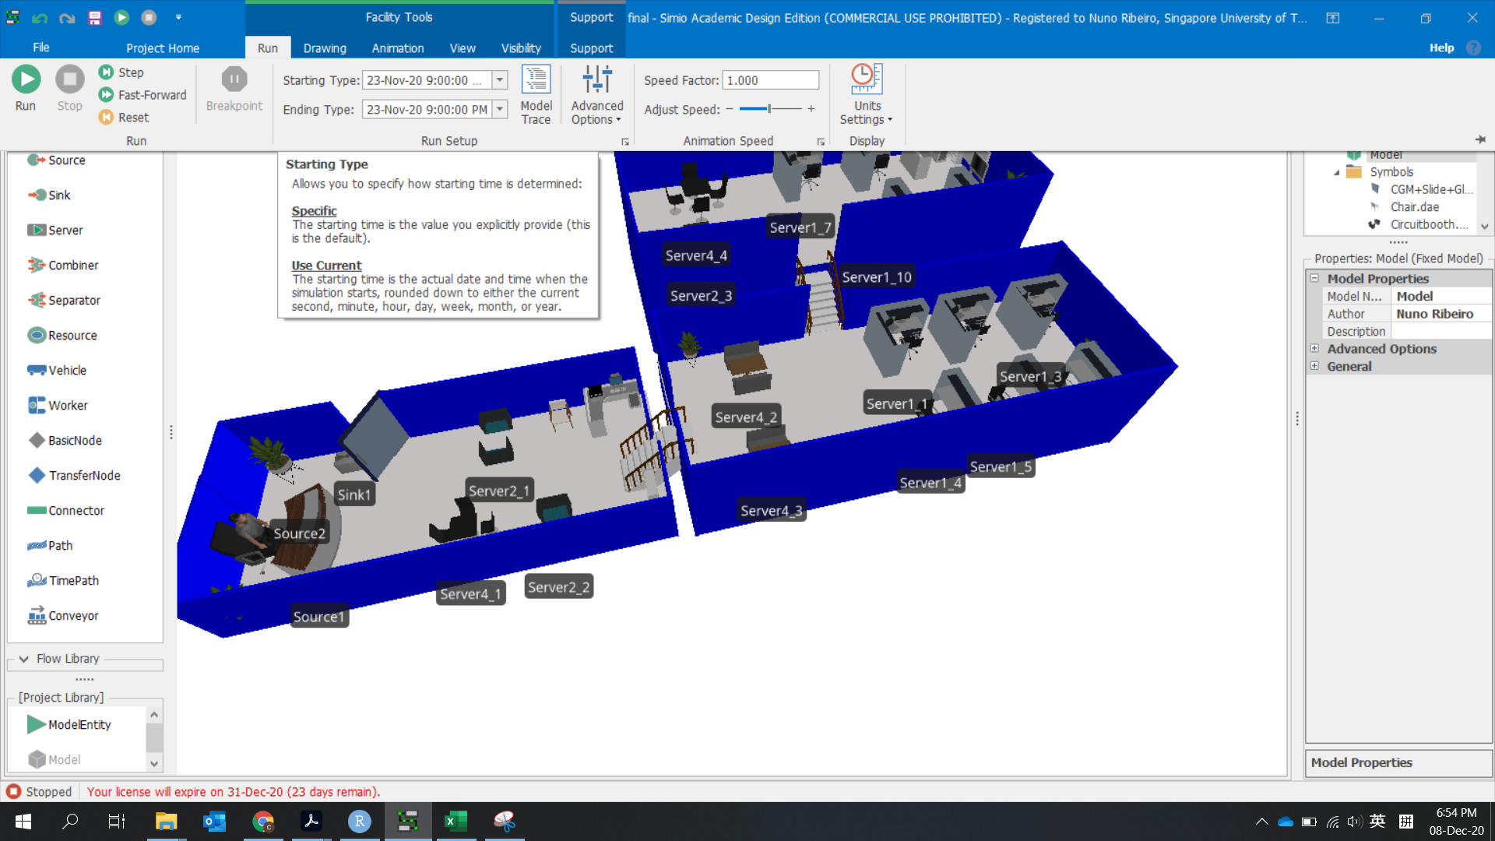
Just Click “Run”!

Slide 14



Model Performance
Operational assumptions:
Assumption 1: Student will only come with group size 1,2,4
Assumption 2: Students will use the seats that match their group size (2 students cannot use four pax seat)
Assumption 3: Students that come in as a group will always roughly leave at the same time
Assumption 4: Students will choose available seats as close to exit as possible (fill in the first level and then second level and then third level)
Tracked Stats:
Students in system
Total current number of students of each type (individual, pair, group of 4)
Number of students of each type that failed to find a seat to study.
Average utilization of each seat type throughout the day
Time specific state
14

